Slide 1
Assignment 6
Name – Sahil S. Kadam
Roll no : 150096724124

Slide 2
What is data ? & Different types of data?
Data is organized information that is collected, stored, and analyzed to help make decisions
Quantity
Numbers
Facts
Observations
Measure
Graphs
Information

Slide 3
Quantity
Definition: Refers to numerical data that represents amounts or counts.
Example: The number of employees in a company, units sold, or the population of a city.

Slide 4
Numbers
Definition: Data represented in numerical form, which can be integers, decimals, or fractions.
Example: Temperature readings (25°C), financial figures ($1,000), or scores (85 out of 100).

Slide 5
Facts
Definition: Objective and verifiable pieces of information.
Example: The Earth orbits the Sun, water freezes at 0°C, or a person’s birthdate.

Slide 6
Observations
Definition: Data collected through watching and recording events or phenomena.
Example: Notes taken during an experiment, customer behavior in a store, or weather conditions over time.

Slide 7
Measures
Definition: Data obtained through quantifying characteristics of an object or event.
Example: Length (meters), weight (kilograms), or time (seconds).

Slide 8
Graphs
Definition: Visual representations of data designed to show relationships or trends.
Example: Bar charts, line graphs, pie charts, or scatter plots.

Slide 9
Information
Definition: Processed data that has meaning and context, providing insights or knowledge.
Example: A report summarizing sales trends, an analysis of customer satisfaction scores, or a weather forecast.

Slide 10
What is Information & types of info. ?
Information is data that has been processed, organized, and structured to provide meaning and context. It is the result of interpreting and analyzing raw data, turning it into something useful and understandable.
Descriptive
Quantative
Qualitative
Historical
Analytical

Slide 11
Descriptive
Definition: Information that describes characteristics or details about an object, event, or situation.
Example: A product description on an e-commerce site, detailing its features, dimensions, and specifications.

Slide 12
Quantative
Definition: Information expressed in numerical terms, used for measurement and comparison.
Example: Annual revenue figures, test scores, or population statistics.

Slide 13
Qualitative
Definition: Non-numerical information that provides insights into the qualities or characteristics of something.
Example: Customer feedback and reviews, interview transcripts, or observations from a field study.

Slide 14
Historical
Definition: Information about past events or data collected over time.
Example: Historical weather records, archives of old newspapers, or company financial reports from previous years.

Slide 15
Analytical
Definition: Information derived from the analysis of data, providing insights and conclusions.
Example: Business intelligence reports summarizing sales trends, a market analysis report predicting future consumer behavior, or a SWOT analysis.

Slide 16
LOW-CODE

Slide 17
Difference b/w low and no code
LOW CODE
NO - CODE
Aimed towards developers
Offers more flexibility
Sustainable for complex apps
Speeds up development with less coding
Aimed to towards citizen – Developers
Limited tools and features
Suitable for simple apps
Fastst developmet speed with no code

Slide 18
Benefits of LOW CODE
Enables faster development of apps
Reduced development costs
Increaed productivity
Enhanced collaboration
Quick prototyping

Slide 19
Advantages of LOW CODE
Flexibility of customization
Seamless Integration with other tools
More scalable as compared to no code
Improved Agility
Consistent Quality

Slide 20
Disadvantages of LOW CODE
Limited Customization
Vendor Lock in
Security Concerns
Performance Issues
Learning Curve

Slide 21
Low –code essentials

Slide 22

Appain
Unique Feature: Strong case management and BPM (Business Process Management) capabilities.
Industry: Financial Services, Healthcare, Government.

Slide 23
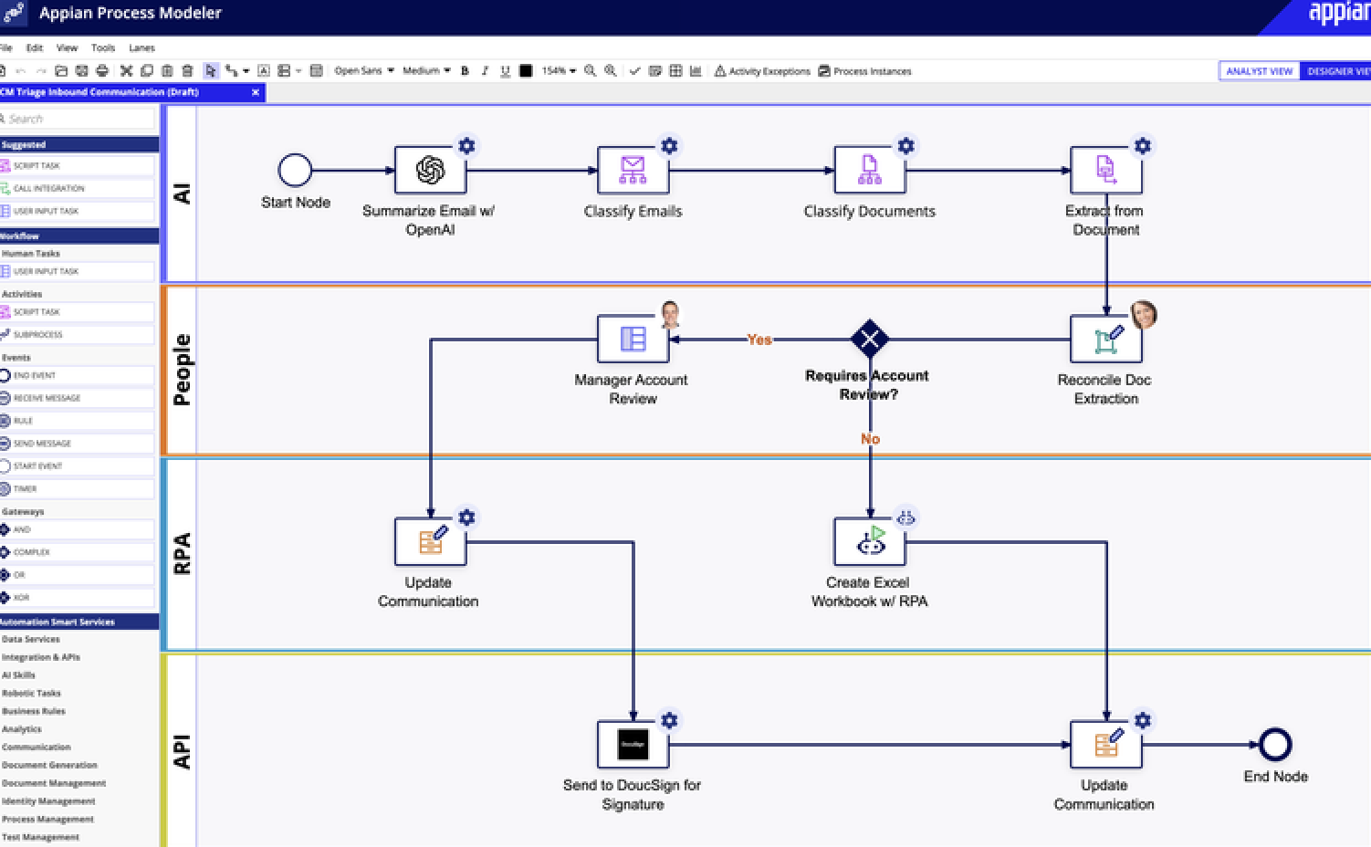

Slide 24

Appsmith
Unique Feature: Real-time collaboration and integration with various data sources.
Industry: IT Services, E-commerce, Education.

Slide 25
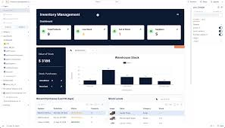

Slide 26

Xano
Unique Feature: Built-in data visualization and analytics tools.
Industry: Marketing, Real Estate, Retail.

Slide 27

Superblocks
Unique Feature: Focuses on building secure internal applications with compliance features.
Industry: Healthcare, Financial Services, Manufacturing.

Slide 28
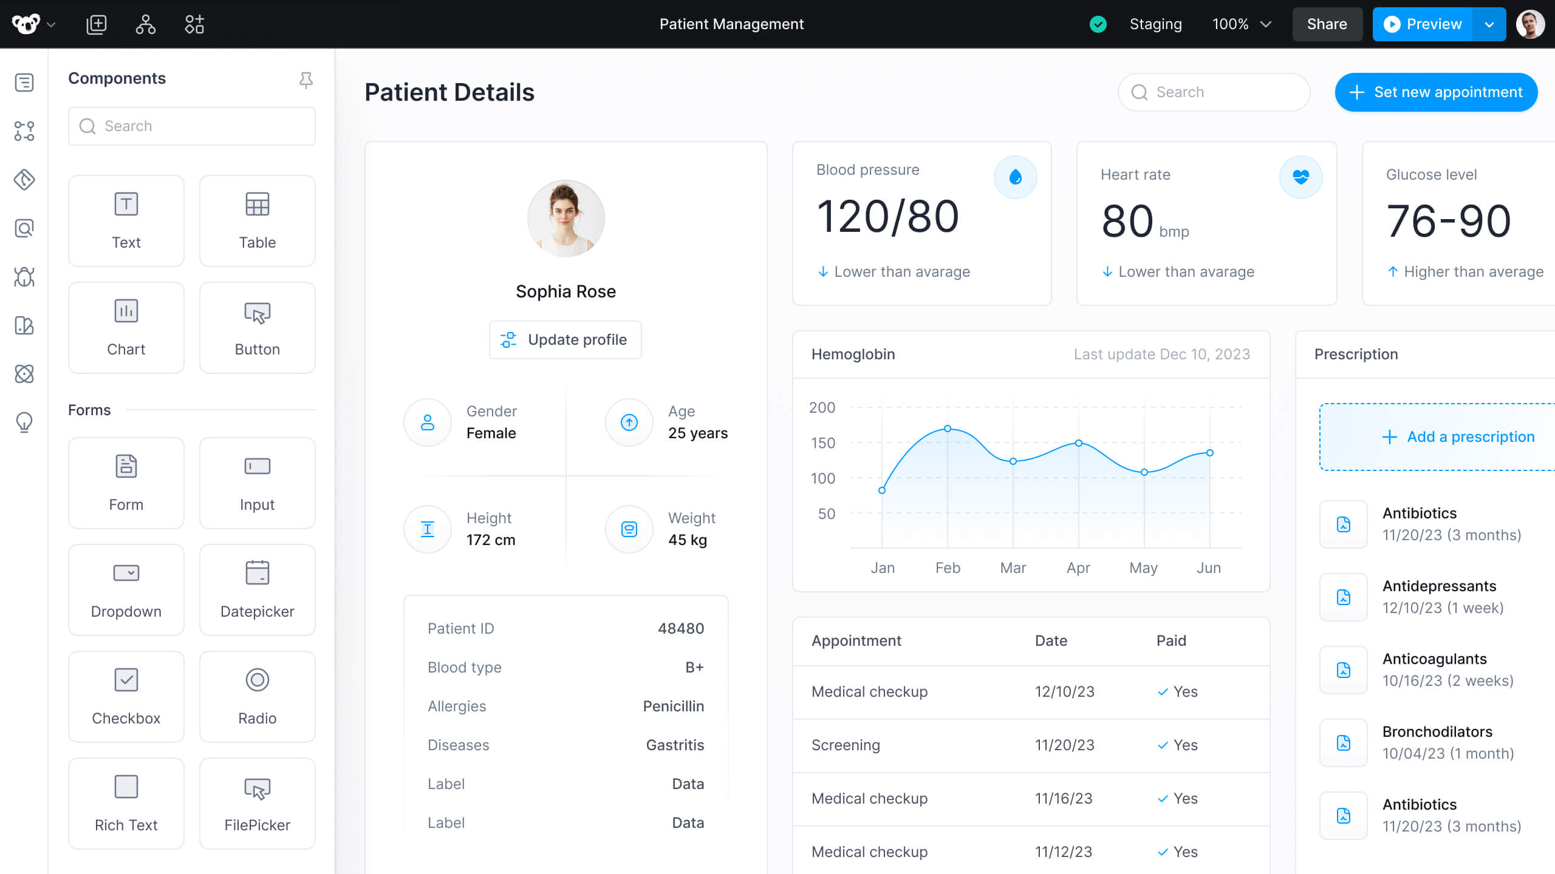

Slide 29

Mendix
Unique Feature: Agile development with strong DevOps integration.
Industry: Software Development, Manufacturing, Retail.

Slide 30
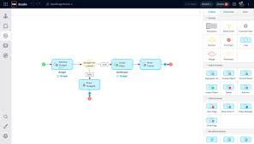

Slide 31

Nintex
Unique Feature: Advanced workflow automation and process management.
Industry: Healthcare, Government, Financial Services.

Slide 32

Studio Creatio
Unique Feature: Comprehensive CRM and BPM solutions with a low-code approach.
Industry: Customer Service, Sales, Marketing.

Slide 33
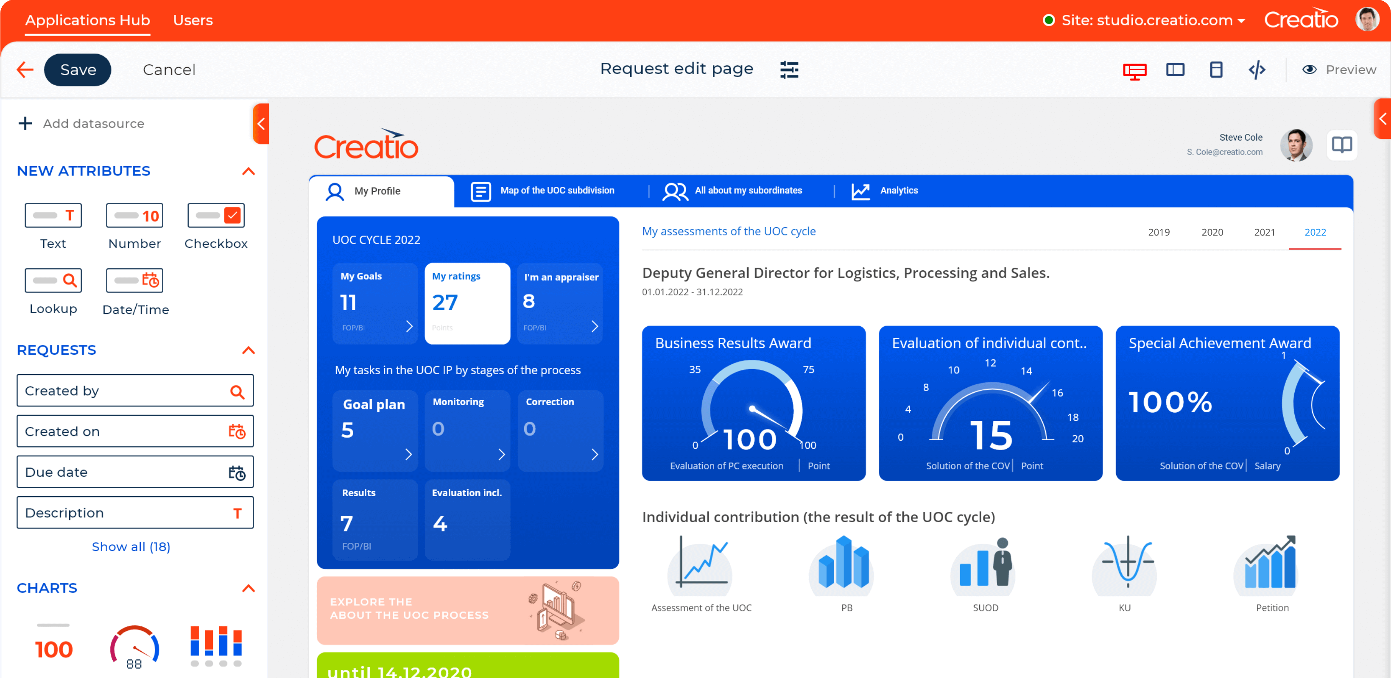

Slide 34

Caspio
Unique Feature: Easy-to-use platform for building database applications without coding.
Industry: Education, Real Estate, Non-profits.

Slide 35
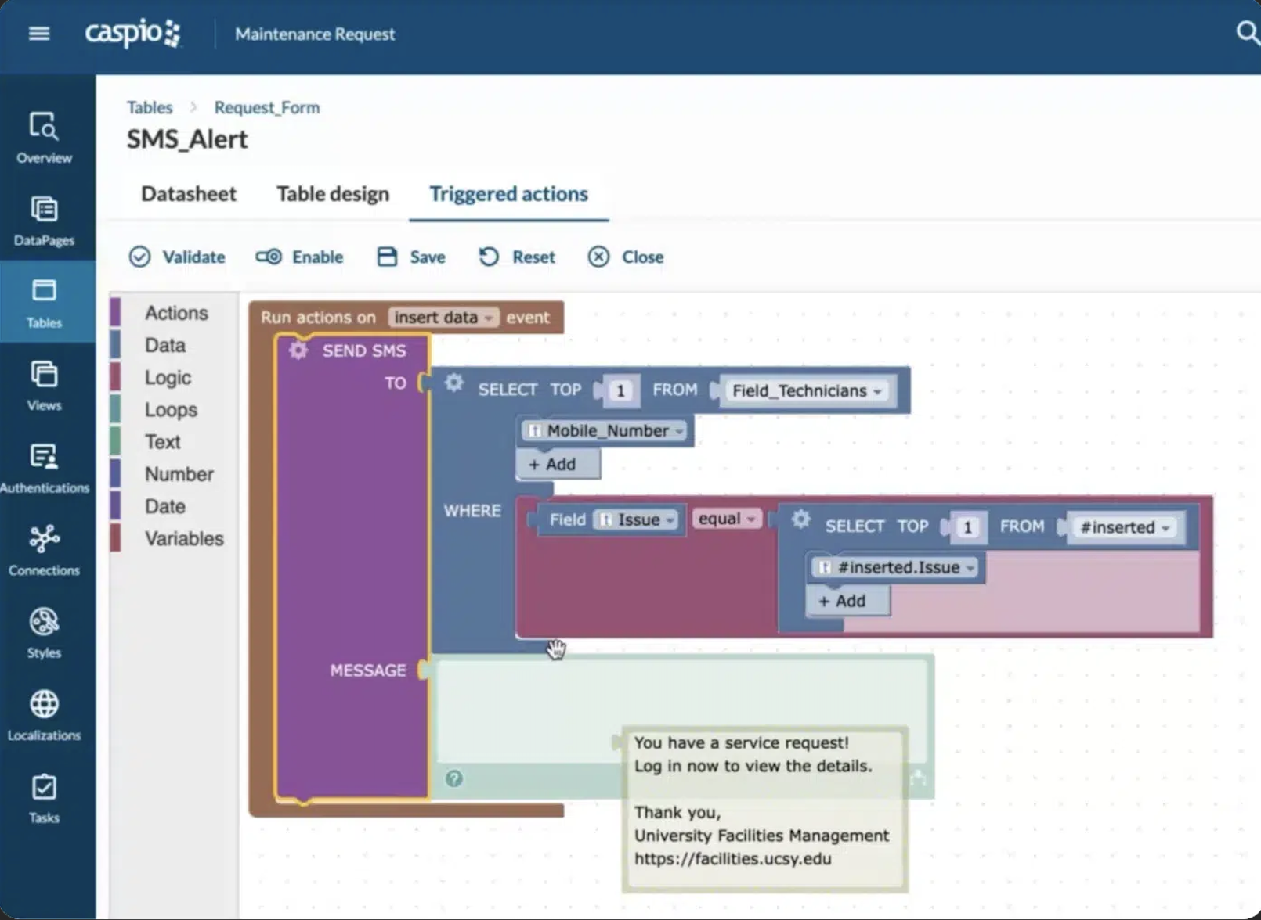

Slide 36

WaveMaker
Unique Feature: Focuses on enterprise-grade application development with a low-code platform.
Industry: Financial Services, Healthcare, Manufacturing.

Slide 37
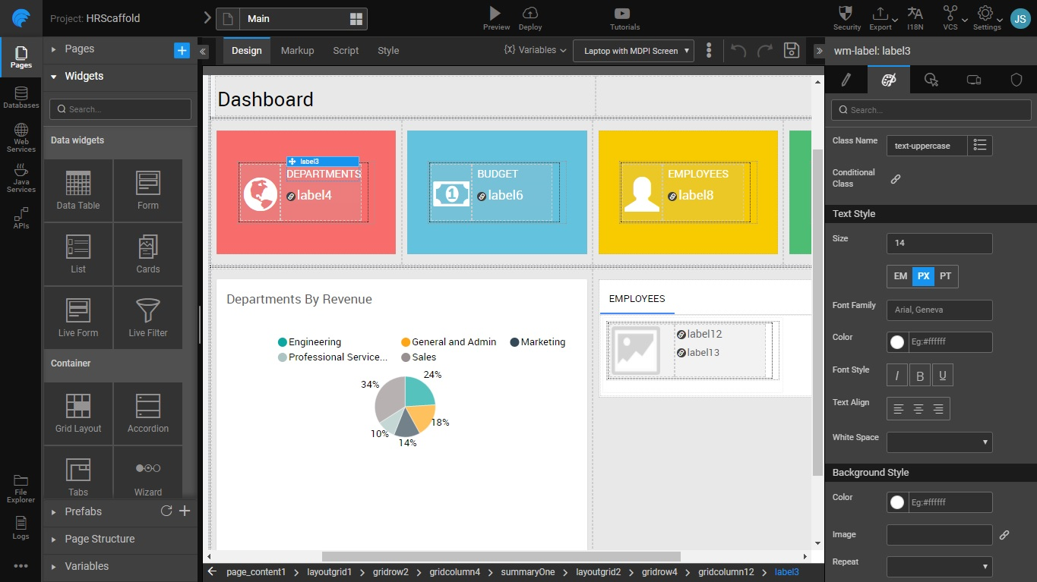

Slide 38

Jotform Apps
Unique Feature: User-friendly form and survey creation with seamless integration options.
Industry: Marketing, Education, E-commerce.

Slide 39
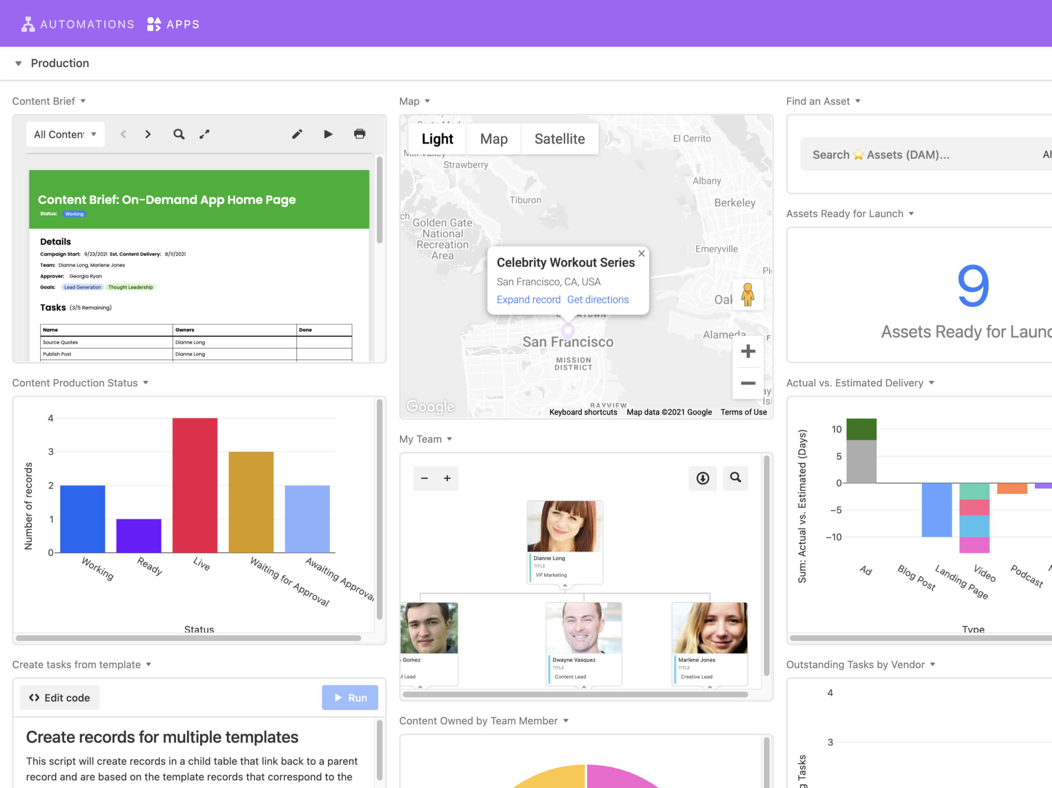

Slide 40
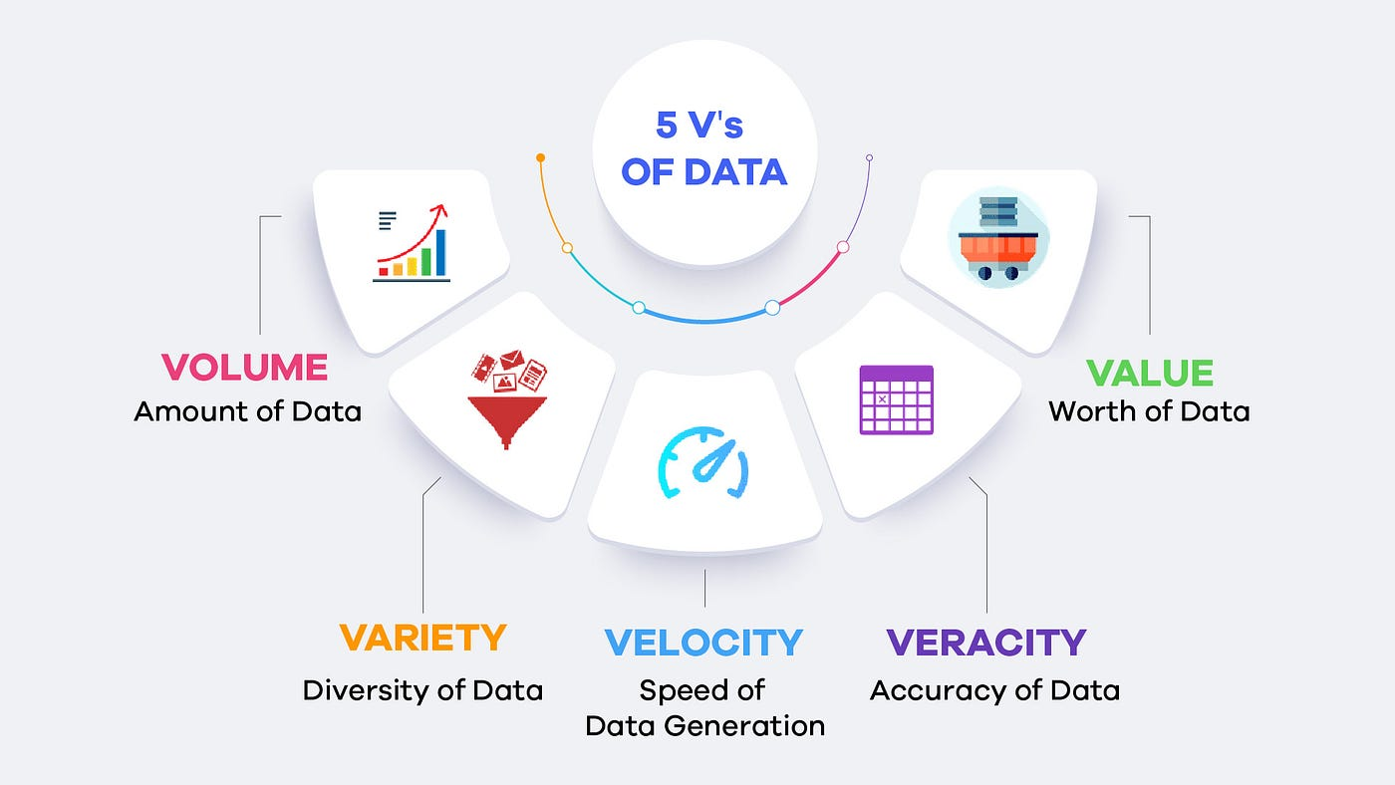
5 Types of V

Slide 41
VOLUME
Definition: Refers to the amount of data that is generated and stored. It's one of the primary characteristics that makes data "big."
Example: Data generated every second from social media platforms, sensors, transactions, and more, reaching petabytes and exabytes.

Slide 42
VARIETY
Definition: The different types of data that are available. This includes structured, unstructured, and semi-structured data.
Example: Text, images, videos, audio files, sensor data, and more. Different formats require different tools and technologies to process.

Slide 43
VELOCITY
Definition: The speed at which data is generated and processed. In today's fast-paced world, the ability to process data in real-time or near-real-time is crucial.
Example: Real-time data processing for stock trading, online transaction processing systems, or social media updates.

Slide 44
VERACITY
Definition: The trustworthiness and accuracy of the data. Veracity addresses the quality of the data and its reliability.
Example: Ensuring data integrity by filtering out biases, inaccuracies, or errors in datasets from different sources.

Slide 45
VALUE
Definition: The usefulness and relevance of the data. Not all data is valuable, so it's important to identify the data that can provide meaningful insights.
Example: Using big data analytics to gain insights into customer behavior, optimize operations, and drive strategic decision-making.

Slide 46
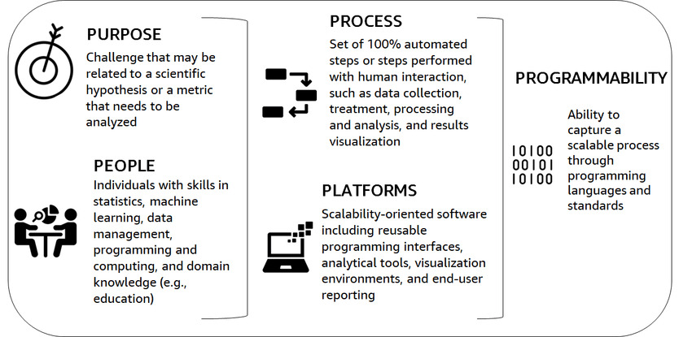
5 Types of P

Slide 47
PURPOSE
Definition: Refers to the objective or goal behind collecting, processing, and analyzing data.
Example: A retail company uses data to understand customer behavior, optimize inventory levels, and enhance the shopping experience. Clearly defined purposes help in focusing efforts and resources on the most valuable data activities.

Slide 48
PEOPLE
Definition: Involves the individuals who interact with data, including data scientists, analysts, and business users.
Example: A successful data strategy requires a team with the right skills and expertise to extract insights from data, ensure data quality, and make data-driven decisions. Training and collaboration across departments enhance data literacy and utilization.

Slide 49
PROCESS
Definition: Encompasses the methodologies and workflows for data collection, storage, processing, and analysis.
Example: Establishing a clear process for data governance, including data validation, cleaning, and integration, ensures data accuracy and reliability. Standardized processes also help in maintaining consistency and compliance.

Slide 50
PLATFORMS
Definition: Refers to the technology and tools used to manage and analyze data.
Example: Cloud-based data platforms, data warehouses, and analytical tools like Tableau, Power BI, or Hadoop enable organizations to store, process, and visualize data efficiently. The right platform choice depends on the organization's needs and scale.

Slide 51
PROGRAMMABILITY
Definition: Involves the ability to program and automate data tasks to enhance efficiency and scalability.
Example: Using programming languages like Python or R for data analysis, automation scripts for data pipelines, and APIs for data integration allows for streamlined operations and faster insights. Programmability also supports advanced analytics and machine learning.

Slide 52
THANK YOU
ANY QUESTIONS ?

